Slide 1
Final Project, Part 1: Lightning Talk
Sierra Costanza
2/21/17

Slide 2
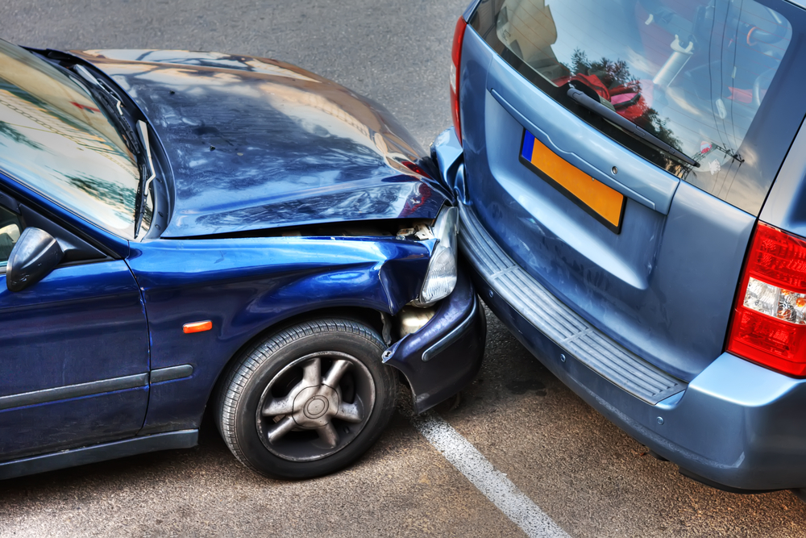
Project 1: Severity of Vehicle Accidents
The Problem: Vehicle accidents are a well-known problem as a leading cause of death (~35,000/year) and injury (~2.4 million) in the US. Building a predictive model to predict the type of injury severity of accidents would help discover behavioral and roadway patterns that could be useful in the development of traffic safety control policy.
Data: The data comes from The Department of Transportation Fatality Analysis Reporting System (FARS) and contains all of the accidents that have occurred on US roads in 2015. There are > 100 features on the accident itself, the vehicles involved, and all persons in each of the vehicles – e.g. the manner of collision, whether a drunk driver was involved, the location, time, make/model of the cars, and demographics of the people involved. The outcome I will predict is the crash injury type: Fatal, Injury Only, Property Damage Only, and Other (multiclass classification problem). Each observation in the accidents data represents a unique accident case, and this case ID column joins to the vehicle and person data tables. The biggest challenge I anticipate will be feature selection and feature engineering.
Hypotheses: The accident, vehicle and person data will allow us to predict the types of accidents that lead to different injury severities or property damage. I have found some similar previous work, but not using this particular 2015 dataset to predict the crash injury type variable.

Slide 3
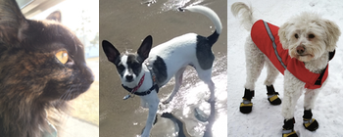
Project 2: Shelter Animal Outcomes
The Problem: Every year, approximately 7.6 million companion animals end up in US shelters – some are given up by their owners, some are picked up after getting lost or taken out of cruelty situations. Many of the animals find families to take them home, but as many as 2.7 million dogs and cats are euthanized in the US every year. We seek to discover trends and insights about animal outcomes that could help shelters focus their energy on specific animals who need extra help finding a new home.
Data: The data comes from the Austin Animal Center from October 2013 to March 2016. The outcome to predict is the status of animals as they leave the animal center which include Adoption, Died, Euthanasia, Return to owner, and Transfer (multiclass classification problem). Each observation represents a unique animal that was released from the animal center, and some of the features include type of animal, sex, age, breed and color.
Hypotheses: The data will allow us to predict the types of animals that have each type of outcome upon being released from the shelter. This was a Kaggle competition that ended on 7/31/16, but I hope to achieve similar results to the top entries and perhaps discover new types of feature transformations and reveal additional insights.

Slide 4

Project 3: Classifying Medical Documents
The Problem: Medical practices handle a large multitude of documents for each of their patients (many coming from different sources) that often require manual work of administrators to classify, compile and file. A model that would automate the process of classifying and filing these documents would help save the practices a considerable amount of time, money and resources.
Data: My friend Brian, an engineer at One Medical, is working on an app that helps medical practices automate these types of tasks. He will provide a dataset containing few hundred labeled medical documents (as images) along with their text. We will select a subset of these types of documents to build a classifier (such as medical history records, lab results and release forms). Each document page is the unit of observation, and features we will extract will contain parsed text and/or visual aspects of the images.
Hypotheses: The text and various visual aspects of the document images will allow us to categorize them with a sufficient degree of accuracy (ideally 70%+). Once we build the model to detect a few categories, we will expand to more categories.

